Slide 1

Introduction to Library Management System
The Library Management System is a comprehensive digital solution for streamlining the operations of a library. It integrates the latest technologies, including Python and MySQL, to provide a seamless experience for both librarians and patrons.
By : Saurabh Kumar
ID : 13883

Slide 2
Key Features of the System
1
Patron Management
2
Inventory Control
Efficiently track patron information, borrowing history, and account status.
Maintain a detailed database of all books, media, and other library materials.
3
Circulation Tracking
4
Reporting and Analytics
Automate the check-in, check-out, and renewal processes for borrowed items.
Generate customized reports and insights to support data-driven decision making.

Slide 3



Software Requirements Specification (SRS)
Detailed Requirements
Thorough Analysis
Clear Specification
The SRS will include a comprehensive list of functional and non-functional requirements for the library management system, covering all key features and user needs.
The SRS will involve in-depth analysis of the system's scope, constraints, and assumptions to ensure a robust and well-planned solution.
The SRS will provide a clear and unambiguous specification of the system's behavior, interfaces, and performance, serving as a blueprint for development.

Slide 4
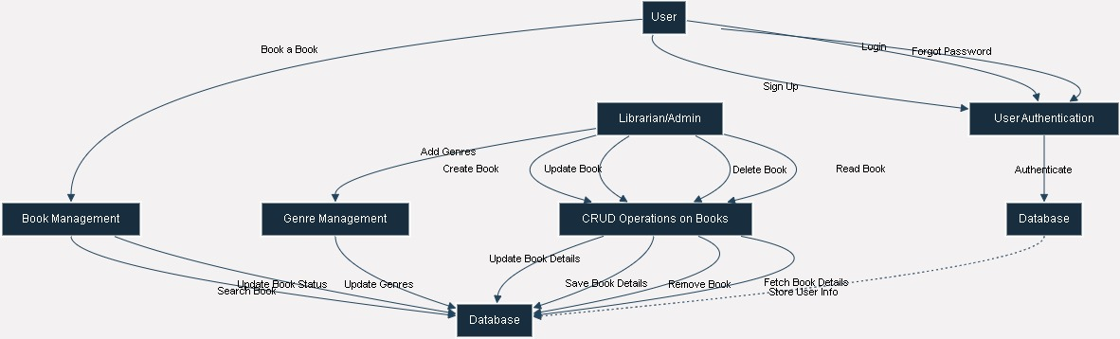
Data Flow Diagram (DFD)
The Data Flow Diagram (DFD) provides a visual representation of the flow of information within a library management system. It depicts the various processes, data stores, and entities involved in the system, allowing for a clear understanding of how data moves and is transformed throughout the application.
The DFD helps identify the inputs, outputs, and storage requirements of the system, facilitating the design and implementation of efficient data management processes.

Slide 5
Process Logic
User Inputs
1
Users can search, borrow, and return books.
Book Management
2
Librarians can add, update, and remove books from the system.
Circulation
3
The system tracks book availability and borrowing history.
The library management system's process logic is designed to provide a seamless experience for users and librarians. Users can easily search the catalog, borrow books, and return them, while librarians can manage the book inventory, including adding new titles, updating information, and removing books that are no longer in circulation. The system also tracks the availability of books and the borrowing history to ensure efficient library operations.

Slide 6
System Architecture
Frontend
Backend
Database
The user-facing interface, built using Python frameworks like tkinter or ttk, provides an intuitive and responsive experience for both librarians and patrons.
The backend, powered by Python, handles all the business logic, data processing, and integration with the MySQL database.
The MySQL database stores all the library data, including patron information, book inventories, circulation records, and more.

Slide 7
Database Design with MySQL
Patrons
Stores patron information, such as name, contact details, and borrowing history.
Books
Maintains the catalog of all books, including title, author, publication details, and availability status.
Checkouts
Tracks the check-out and return dates for each book borrowed by a patron.
Fines
Records any late fees or charges associated with overdue or lost books.

Slide 8



Python Integration and Functionality
User Interface
The Python-based frontend provides an intuitive and responsive user interface for librarians and patrons.
Business Logic
Python scripts handle all the core functionality, such as patron management, book inventory, and circulation tracking.
Database Integration
The Python backend seamlessly integrates with the MySQL database, enabling data storage, retrieval, and analysis.

Slide 9

Circulation Management
1
Check-out
Patrons can easily borrow books by checking them out through the user-friendly interface.
2
Renewals
Patrons can renew their borrowed books online or through the library, as long as the book is not on hold for another patron.
3
Returns
When a patron returns a book, the system automatically updates the book's availability status and the patron's borrowing history.

Slide 10




Patron and Book Inventory
Patron Records
Book Catalog
Search and Discovery
Reporting
Maintain detailed profiles for all library patrons, including contact information, borrowing history, and account status.
Comprehensive database of all books, media, and other library materials, including title, author, publication details, and availability.
Generate detailed reports and analytics to support data-driven decision making and resource management.
Provide advanced search functionality to help patrons easily find and access the resources they need.

Slide 11

Conclusion and Future Enhancements
The Library Management System powered by Python and MySQL offers a comprehensive solution to streamline library operations and enhance the patron experience. As technology continues to evolve, the system can be further enhanced with features like mobile app integration, self-service kiosks, and AI-powered recommendations.

